Slide 1
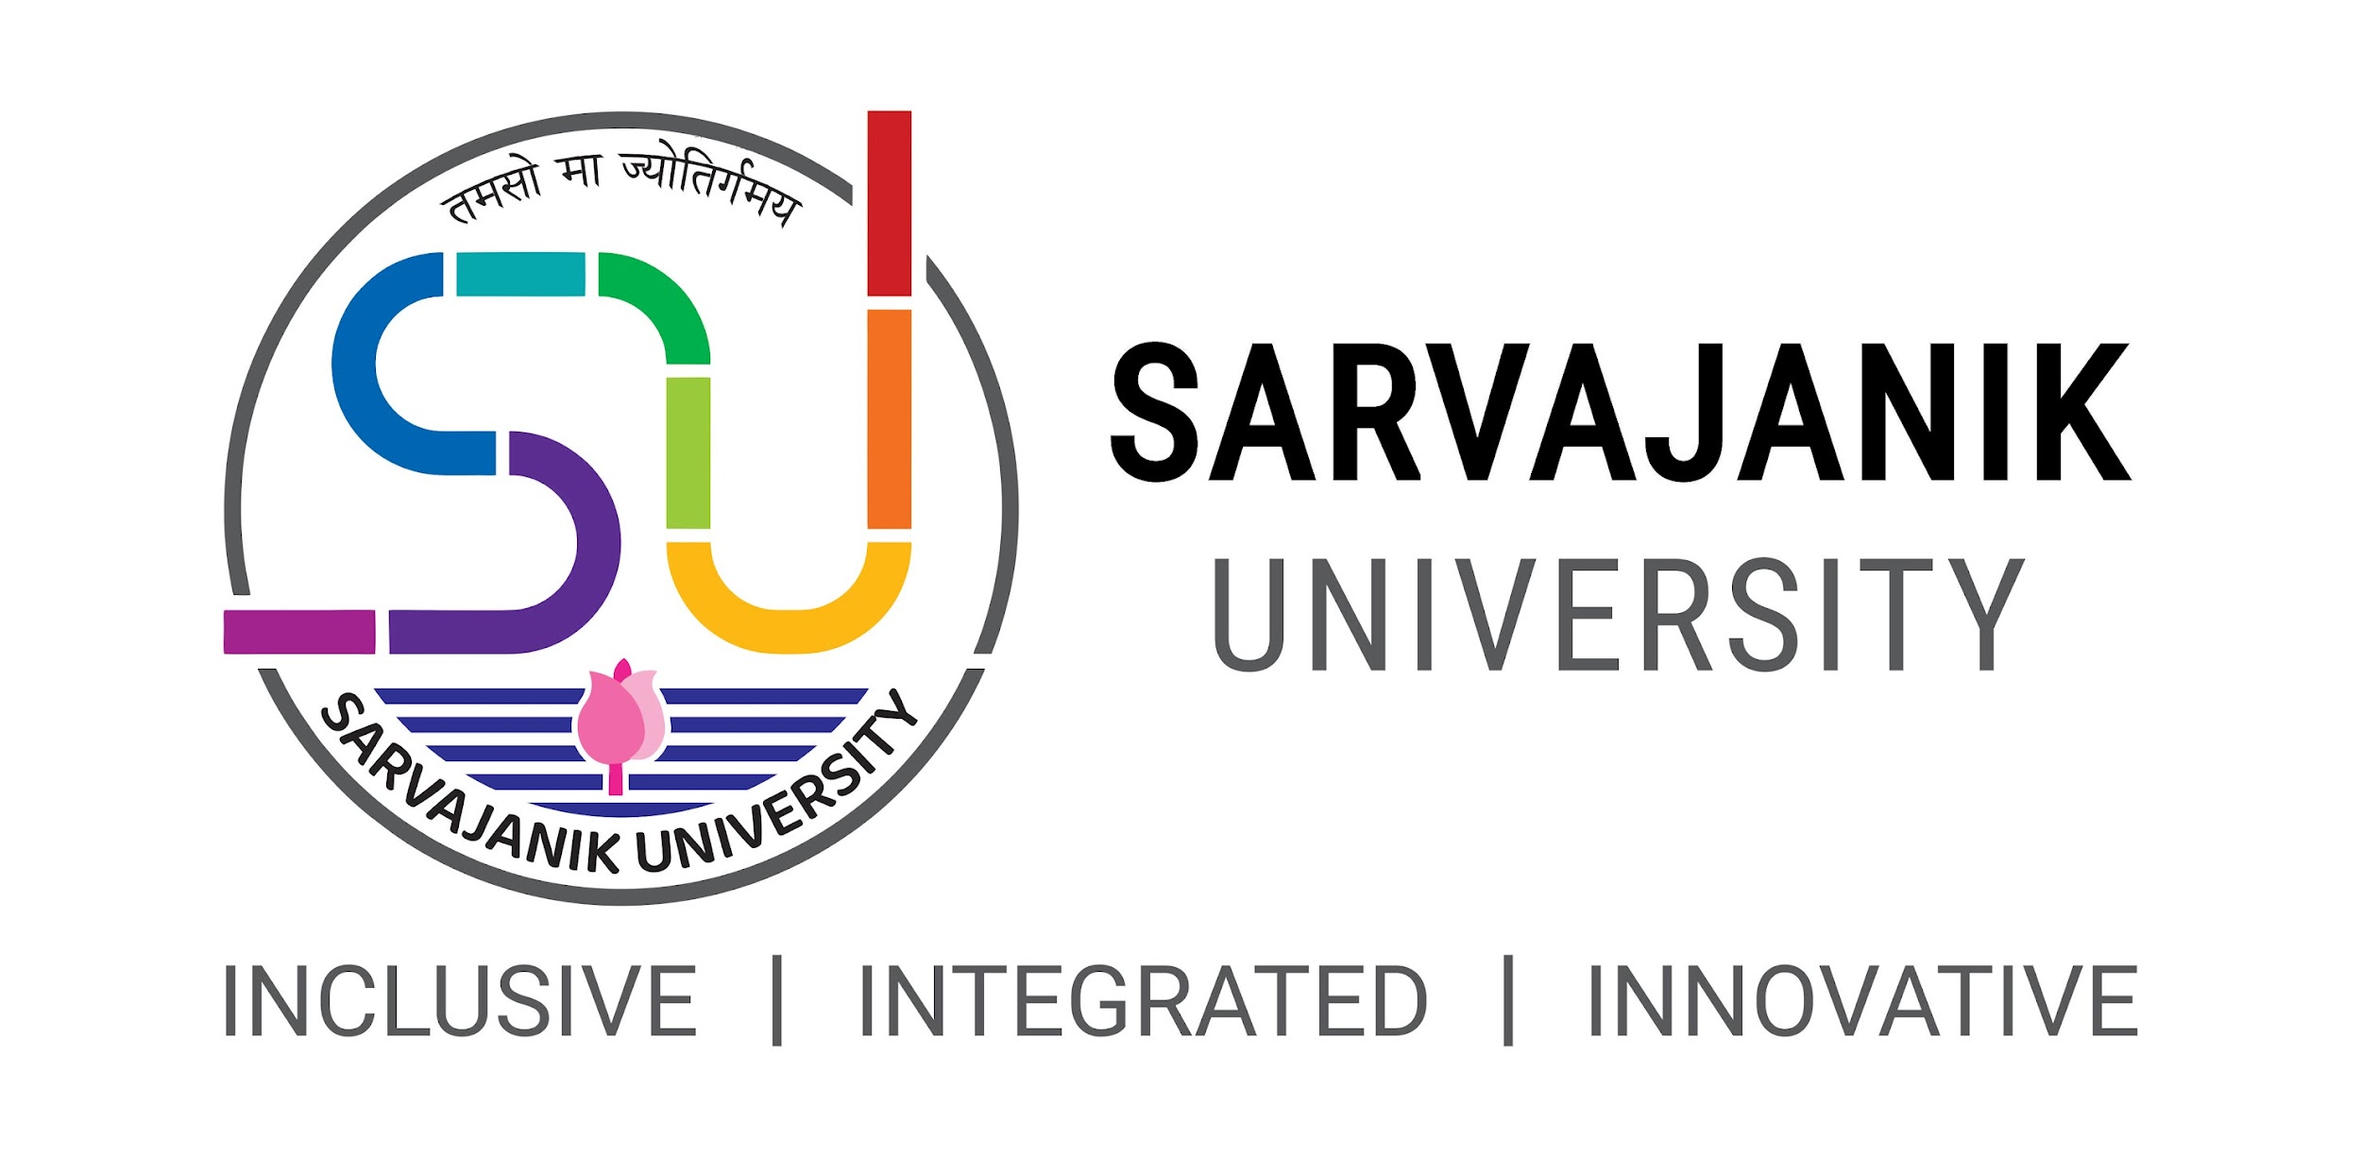

Sarvajanik Education Society Sarvajanik College of Engineering & Technology, Surat. Master of Computer Applications Academic Year: 2023– 24
A Project On
“Student Management System”
Presented By
JHA SHUBHAMKUMAR (ET23MTCA020)
SHAH RUCHITKUMAR (ET23MTCA060)
SOLANKI KHUSHALKUMAR (ET23MTCA062)
M.C.A. I Sem. 1
Under the Guidance of
Prof. Preksha Parmar

Slide 2
Agenda
Project Abstract Objective System Description (Technology Used) Database Design / File System (Table Design) Diagram (Use Case Diagram, Activity Diagram) Screen Shorts Advantages & Limitations References

Slide 3
Project Abstract
Student Management System is application developed for managing student data in school, colleges and institutes. In this system admin is super user who can manage all operations like Manage course, manage Student, Generate login ID & Password ,fees Payment etc. The system provides a platform for teacher and student to view their information in the system.

Slide 4
Objective
Main Objective of the Student Management System is to go with computerized system, instead of old fashioned manual process. As compared to old process this system help to increase Sustainability. In this system admin is super user who can manage all operations related to teacher and students.

Slide 5
System Description
Software Requirement | Dev C++, Turbo C
Hardware requirements | Processor : Minimum 2 GHz Hard Drive : Minimum 64 GB or More Memory : 4 GB or Above
Operating System | Windows 7 or Above

Slide 6
File System (Table Design)
Course | Teacher | Student
Course_Id | Teacher_id | Enrollment_no
Course_Name | Teacher_name | Student_name
Subjects | Date_of_joining | Email_id
 | Mobile_no | Mobile_no
 | Email_id | Address
 | Salary | Date_of_birth
 | - | Marks

Slide 7
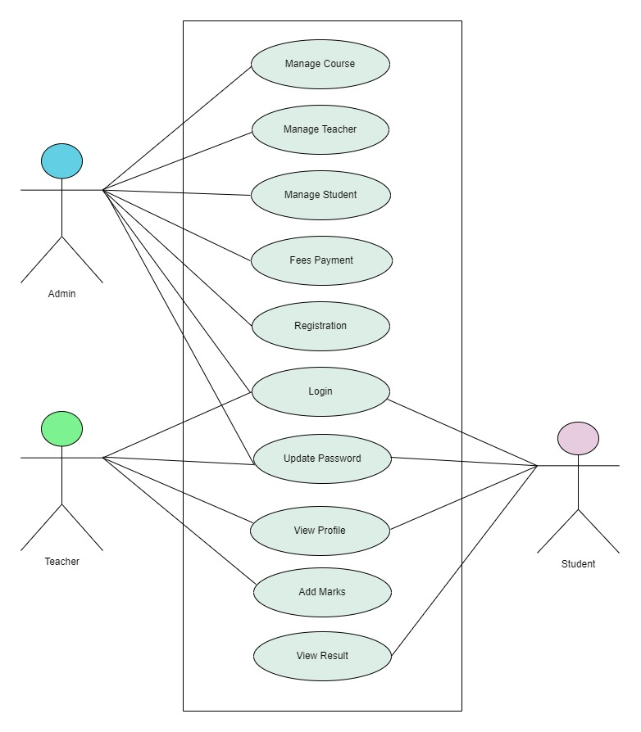
Use Case Diagram

Slide 8
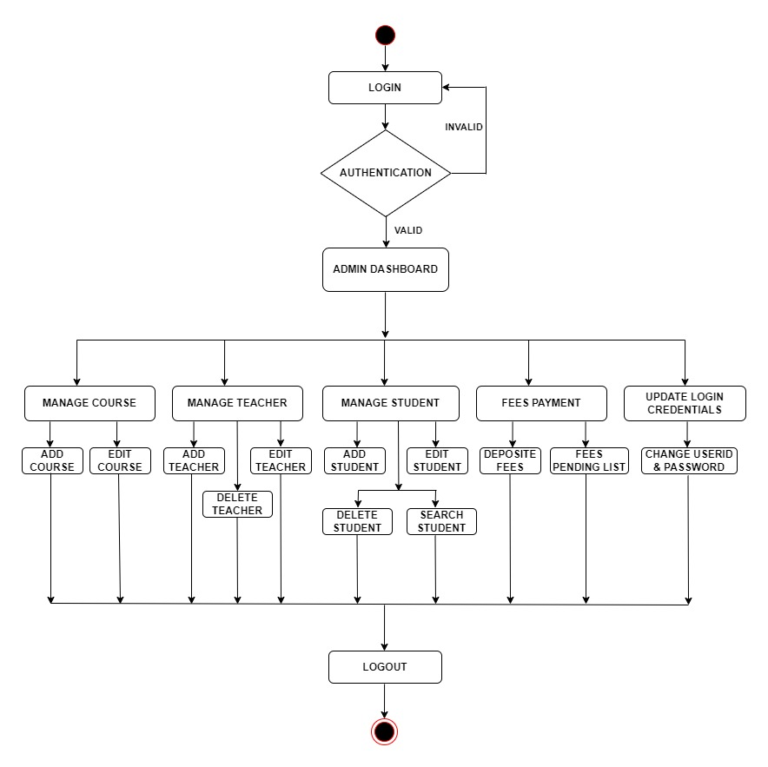
Activity Diagram (Admin)

Slide 9
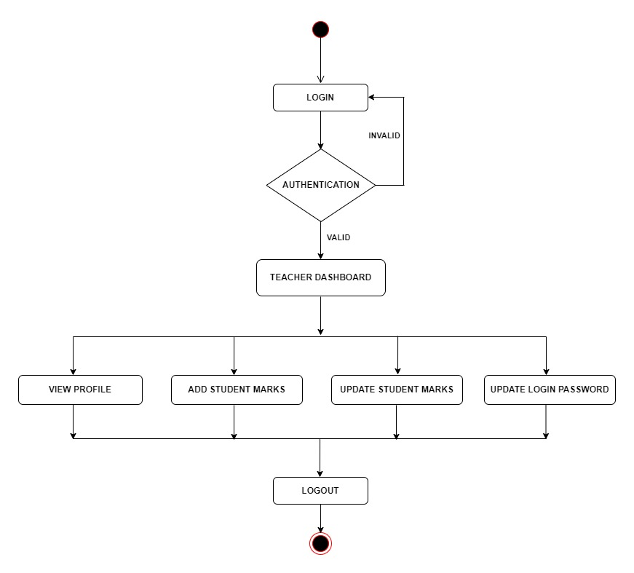
Activity Diagram (Teacher)

Slide 10
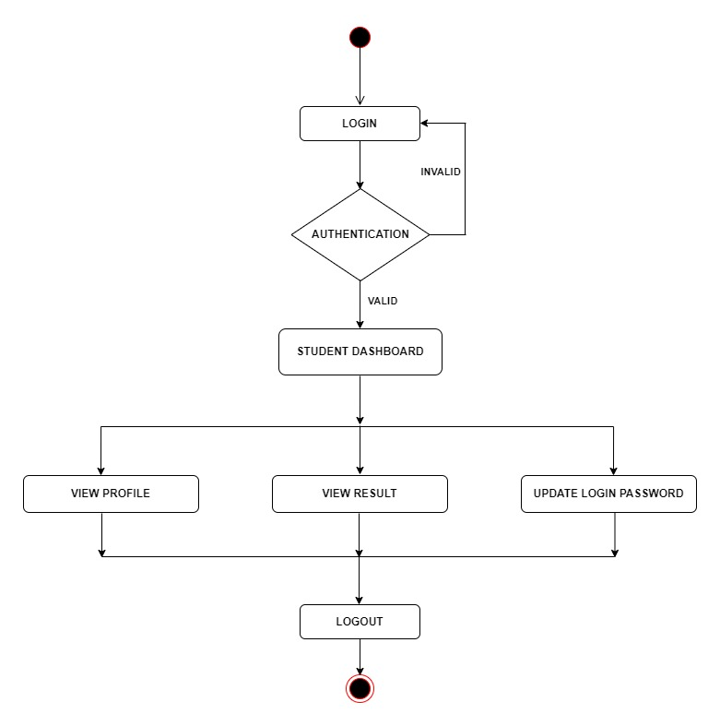
Activity Diagram (Student)

Slide 11
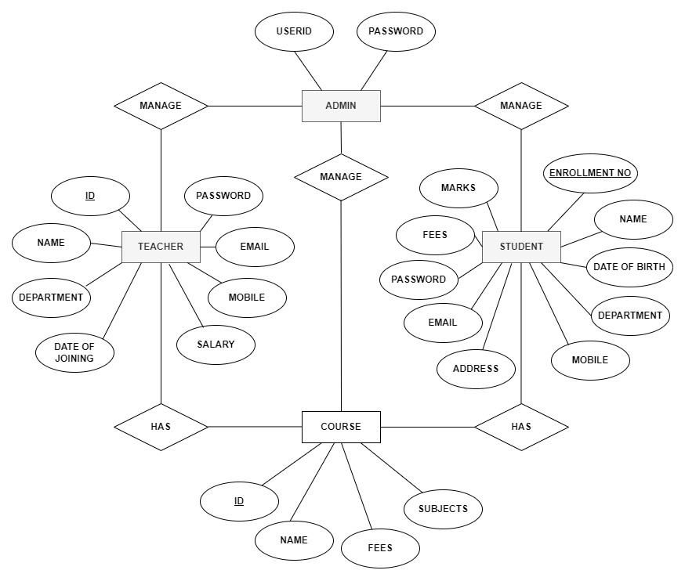
E-R Diagram

Slide 12
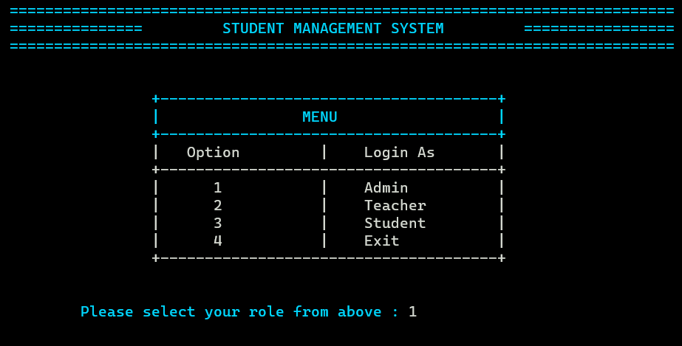
Screen Shorts

Slide 13
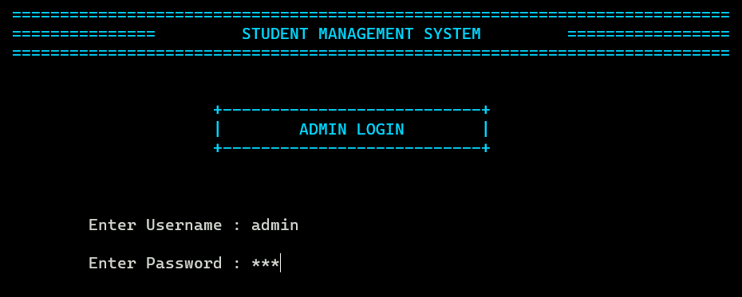
Screen Shorts

Slide 14
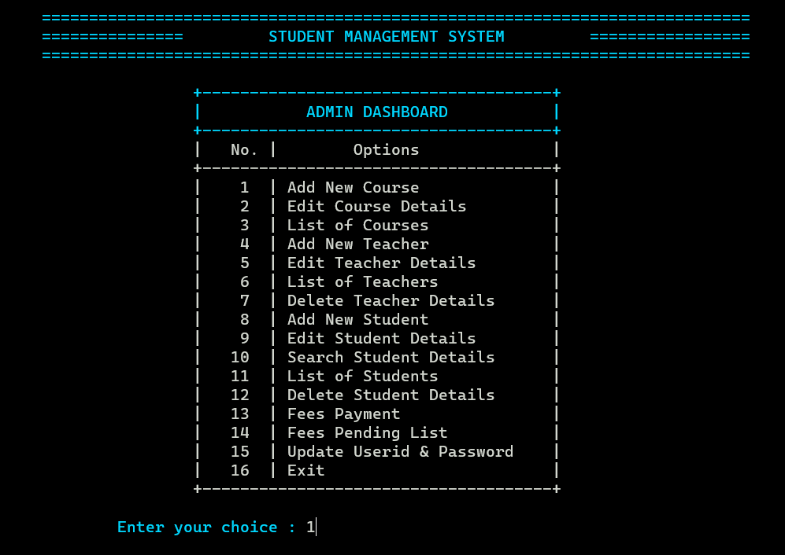
Screen Shorts

Slide 15
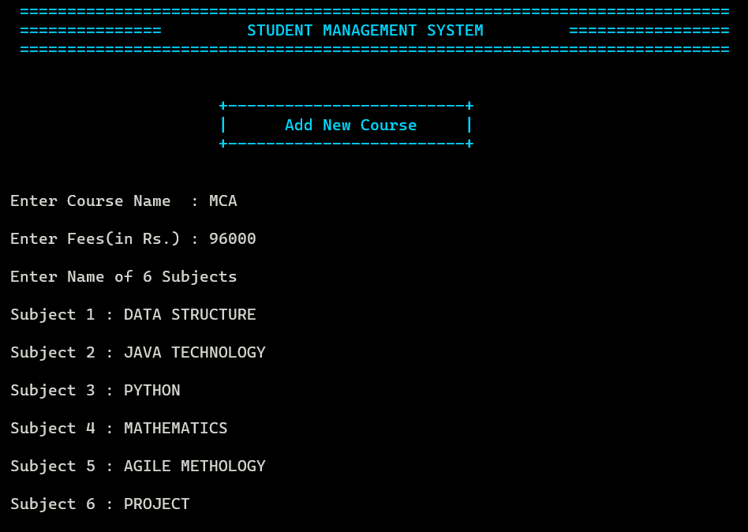
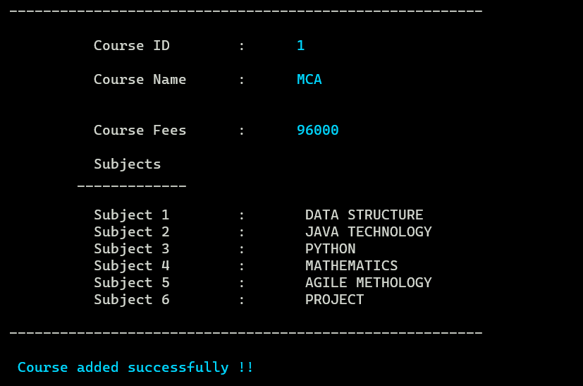
Screen Shorts

Slide 16
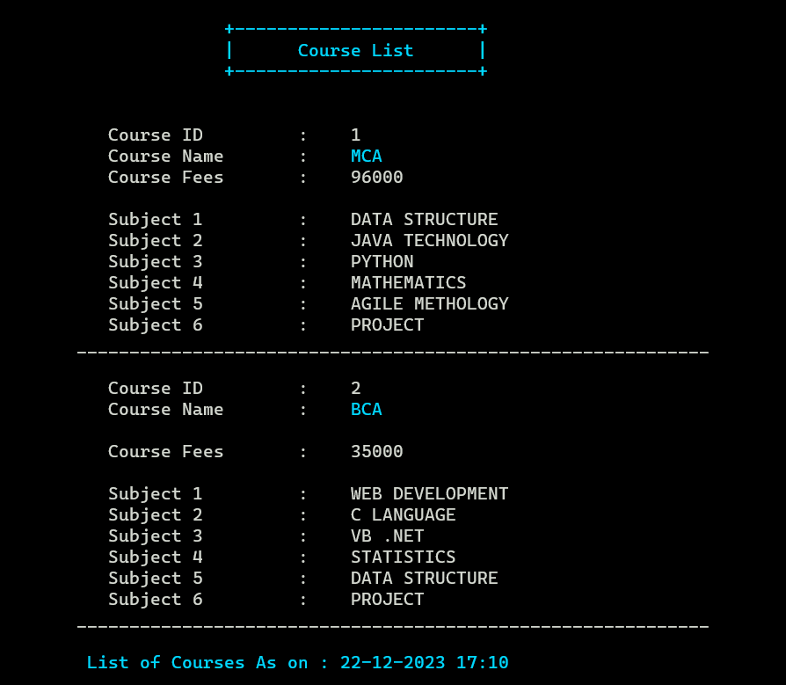
Screen Shorts

Slide 17
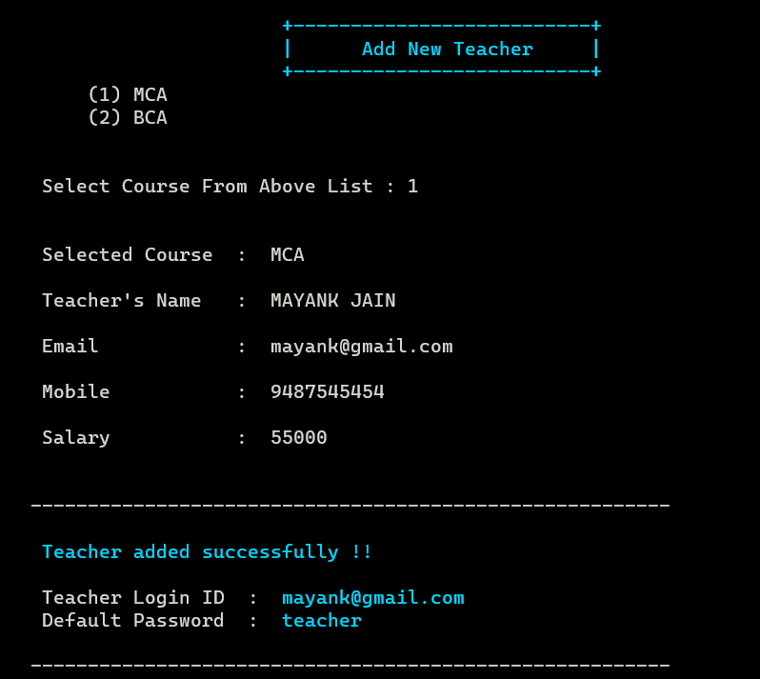
Screen Shorts

Slide 18
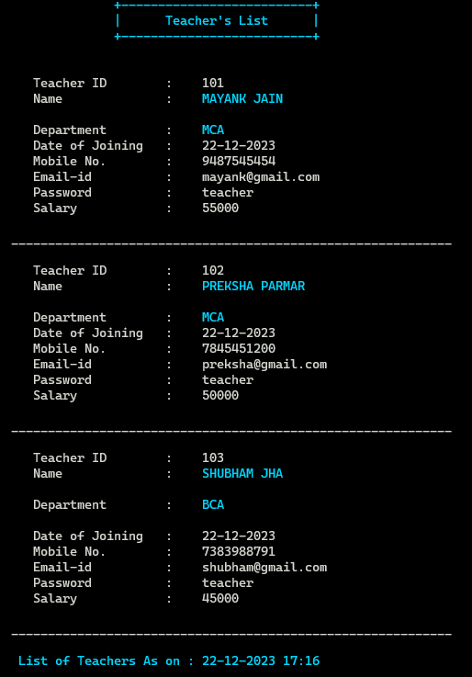
Screen Shorts

Slide 19
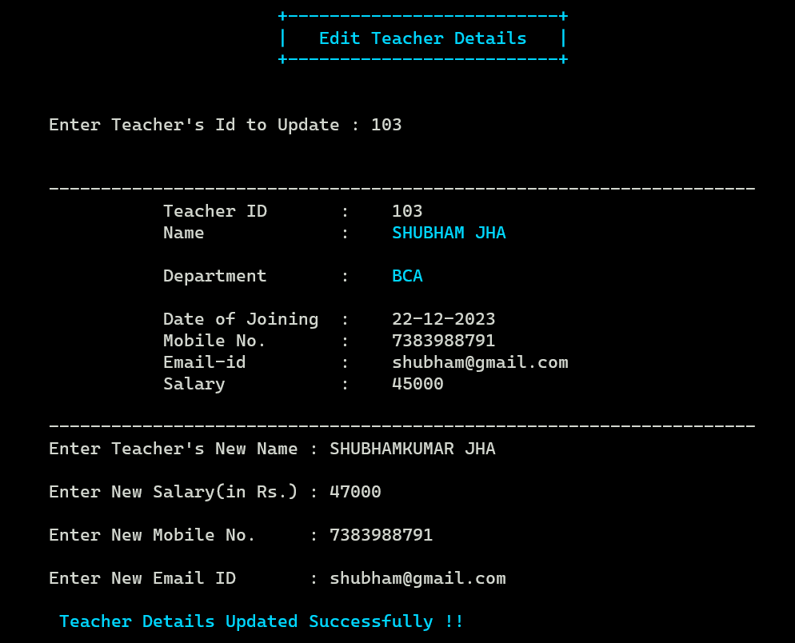
Screen Shorts

Slide 20
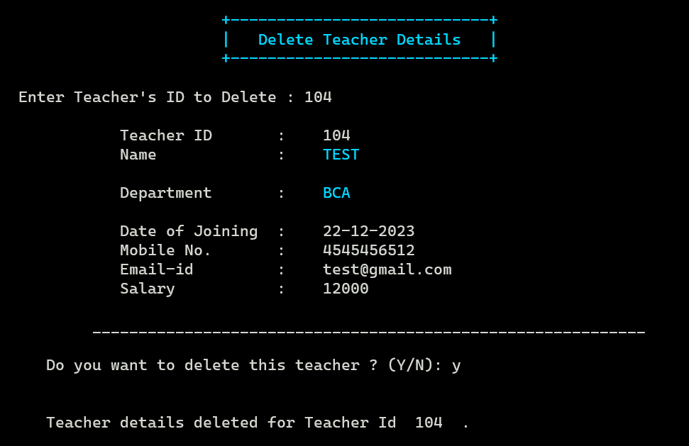
Screen Shorts

Slide 21
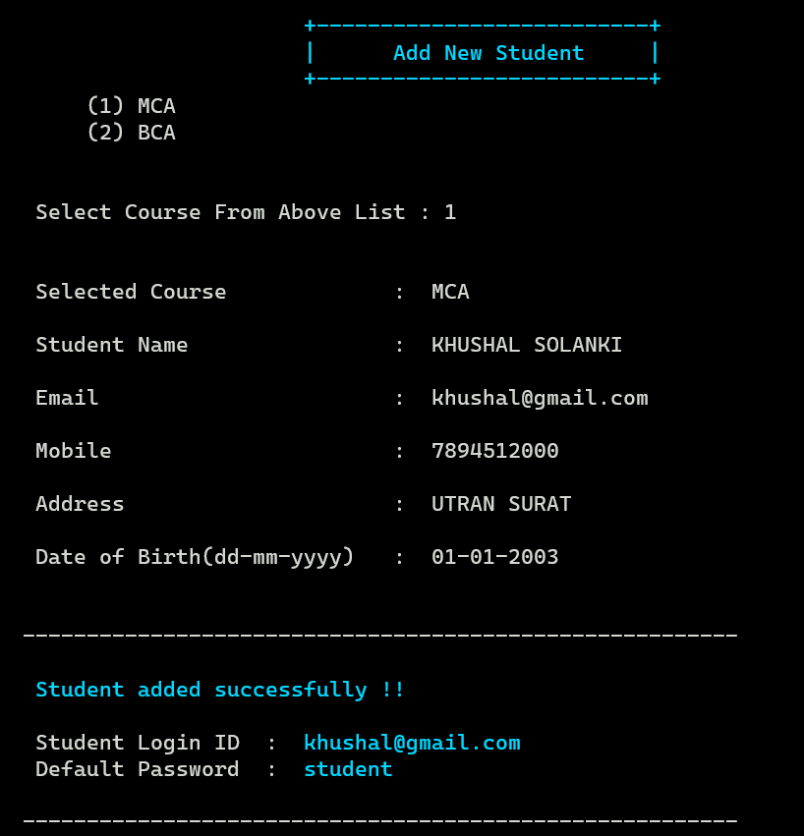
Screen Shorts

Slide 22
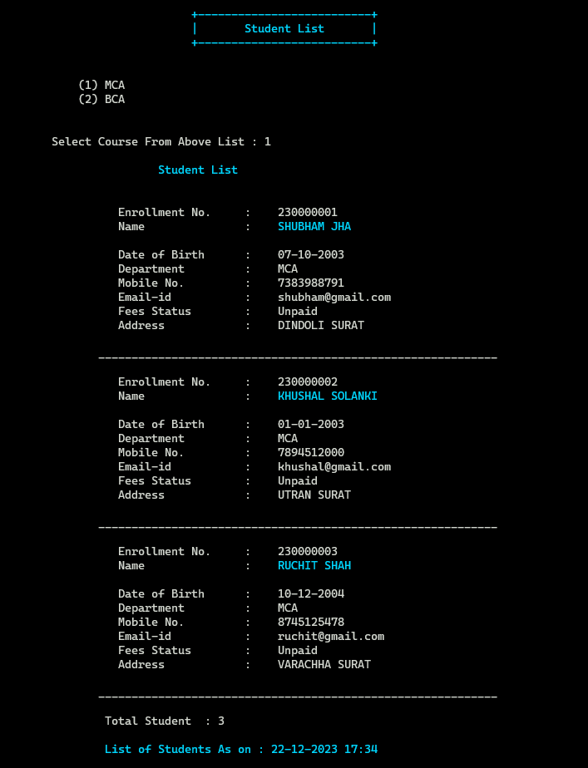
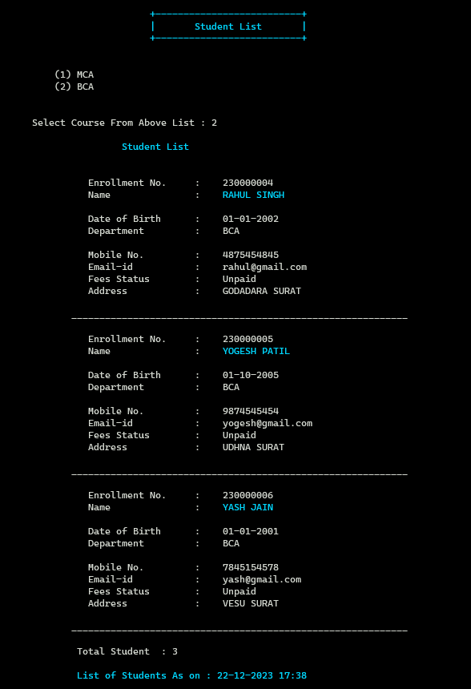
Screen Shorts

Slide 23
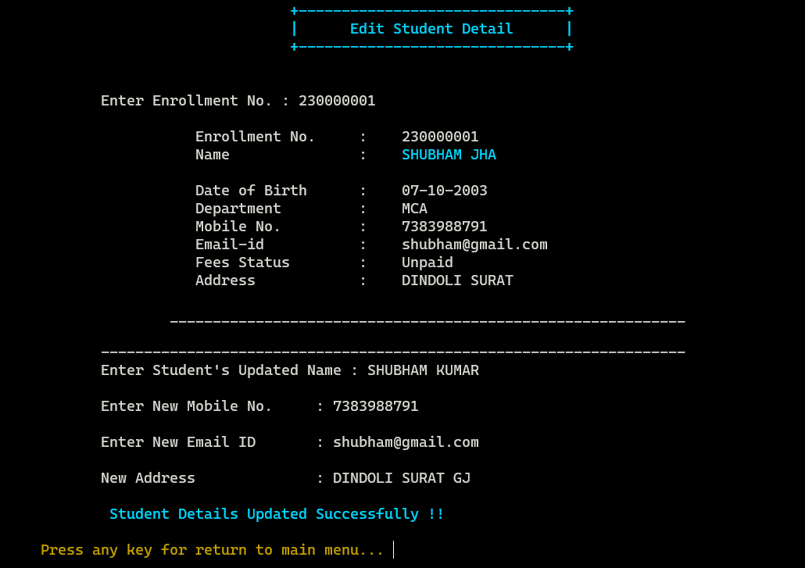
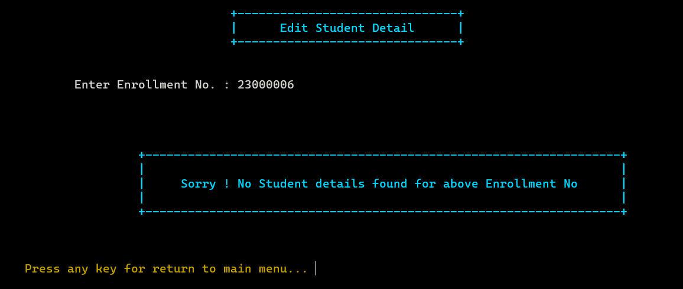
Screen Shorts

Slide 24
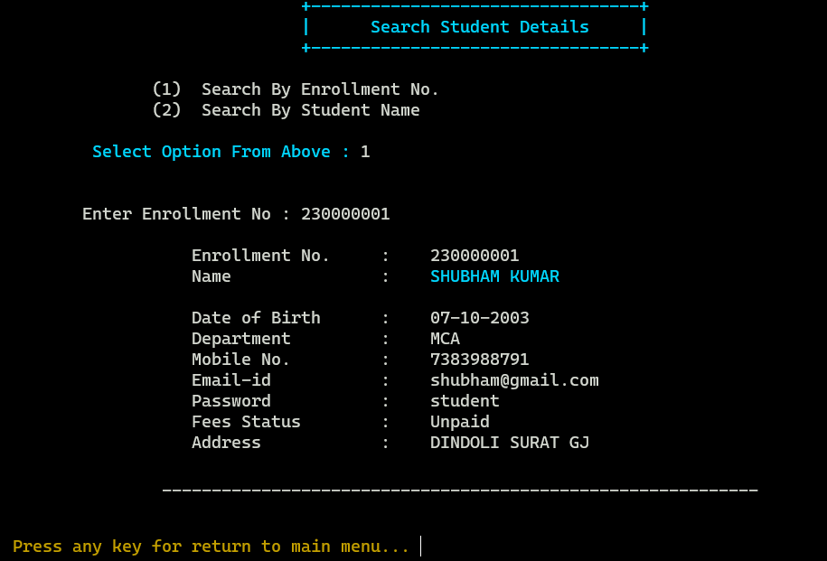
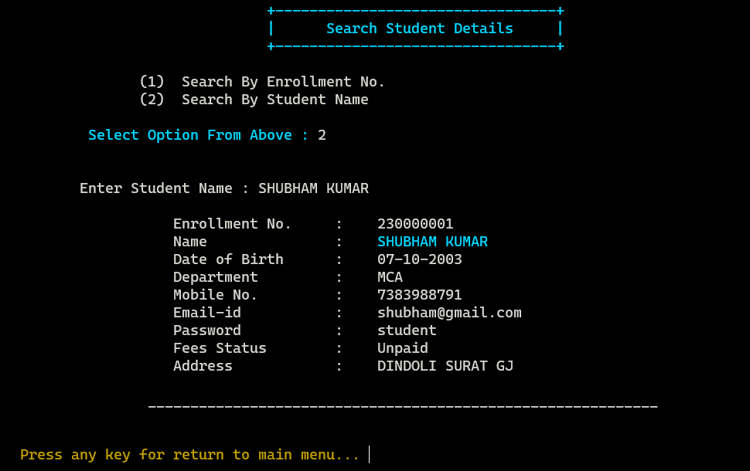
Screen Shorts

Slide 25
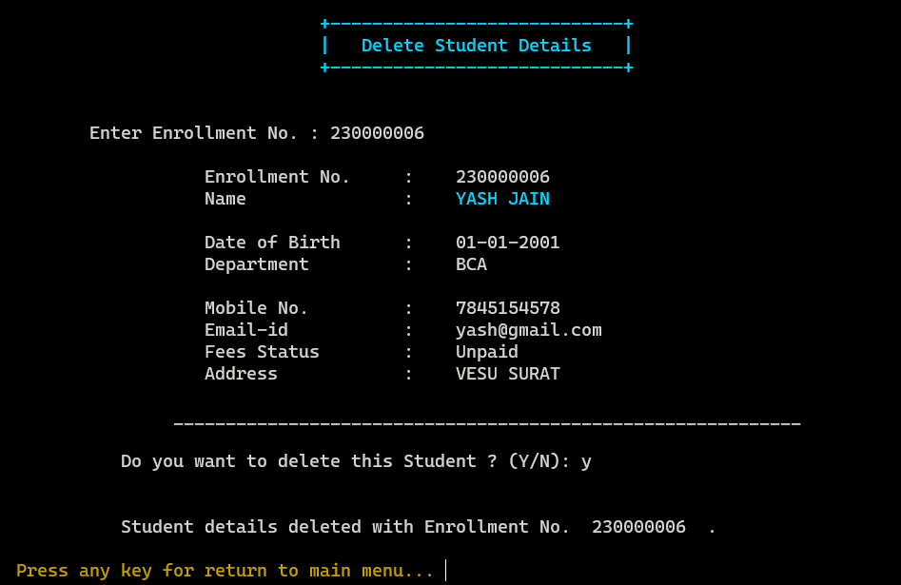
Screen Shorts

Slide 26
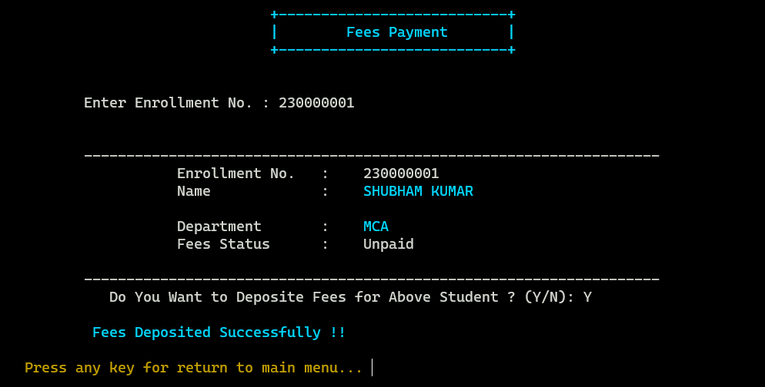
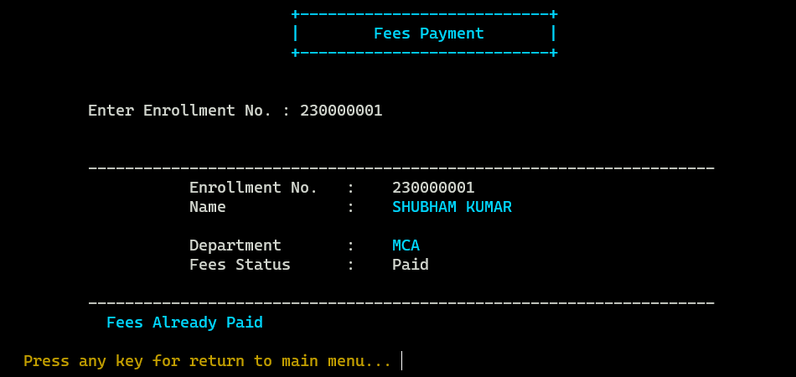
Screen Shorts

Slide 27
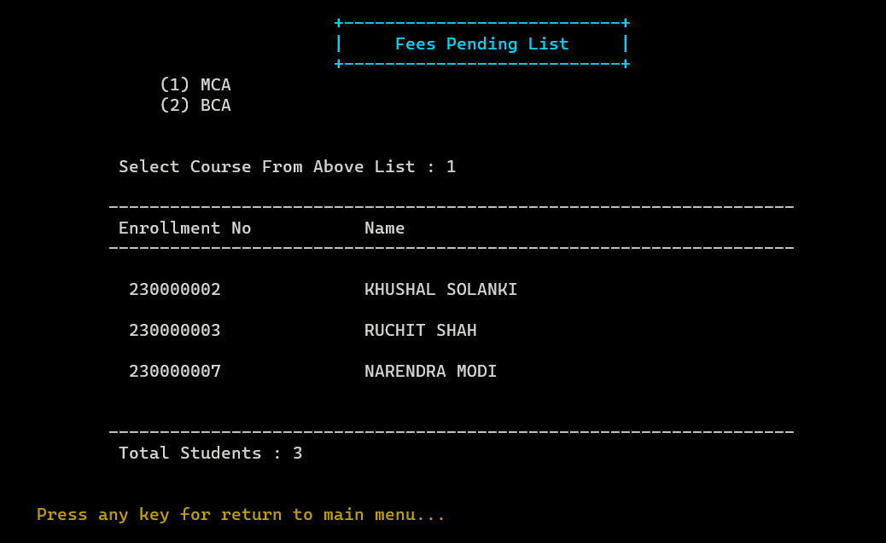
Screen Shorts

Slide 28
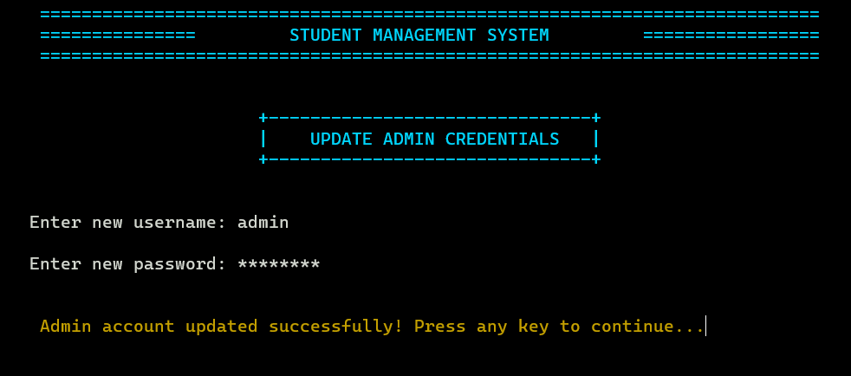
Screen Shorts

Slide 29
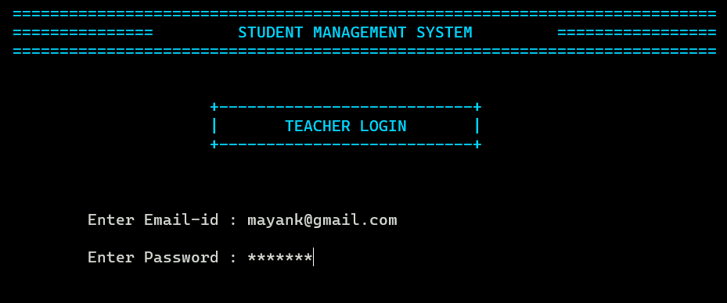
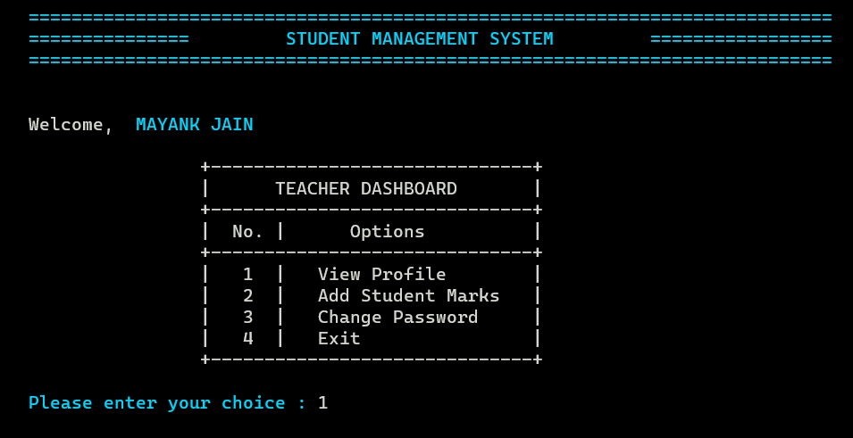
Screen Shorts

Slide 30
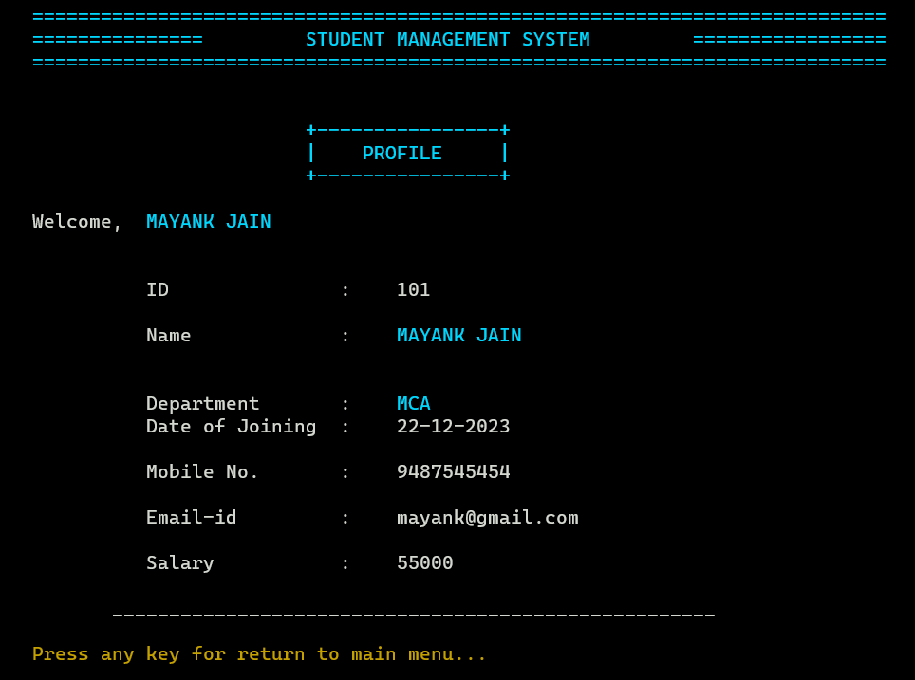
Screen Shorts

Slide 31
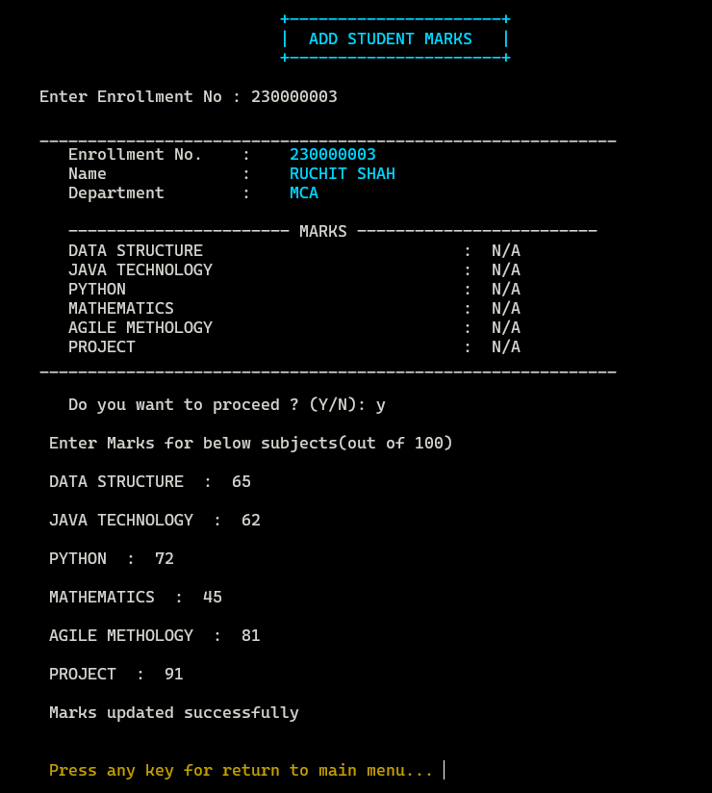
Screen Shorts

Slide 32
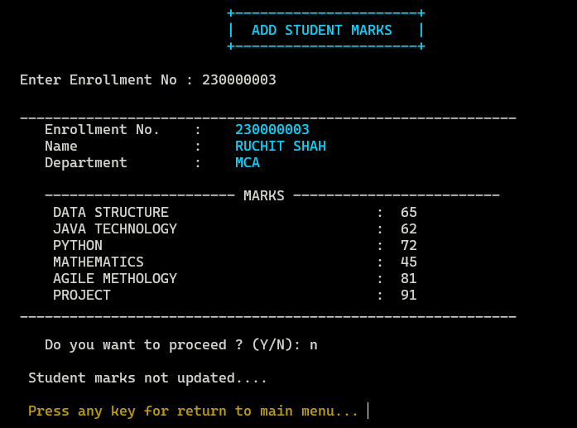
Screen Shorts

Slide 33
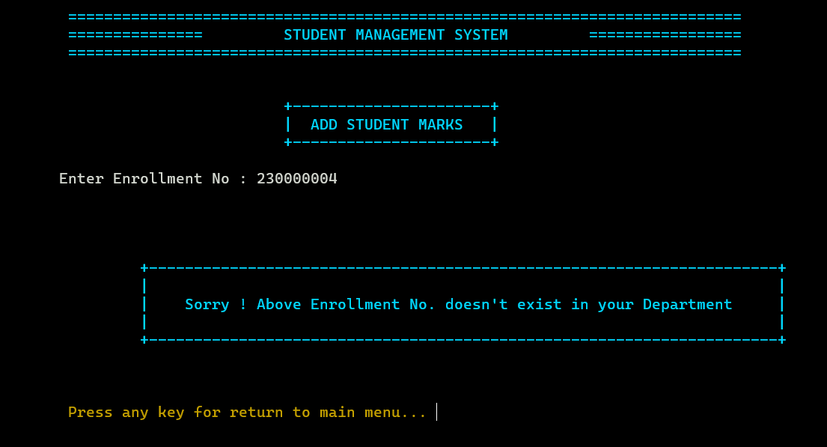
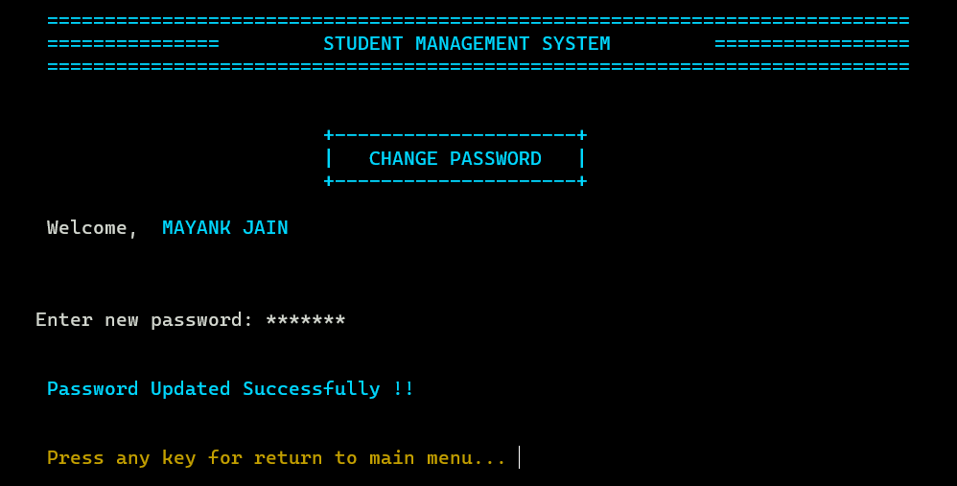
Screen Shorts

Slide 34
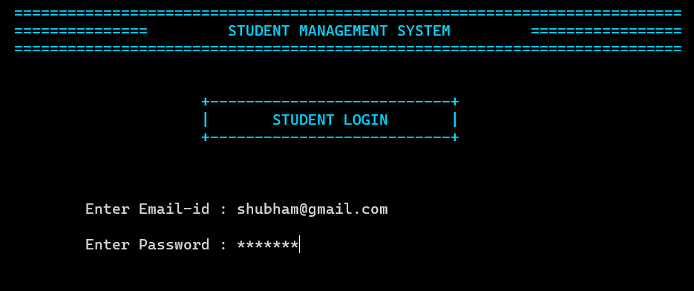
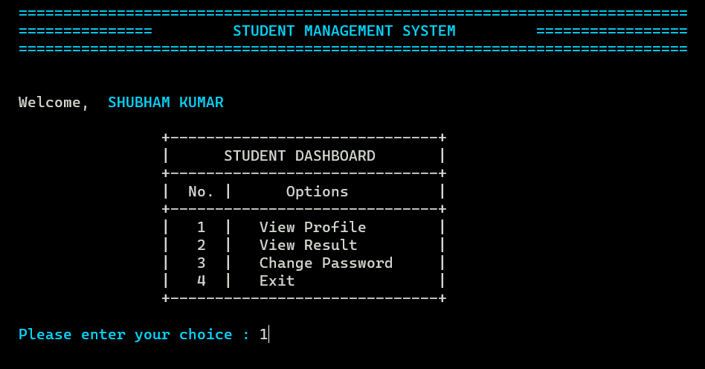
Screen Shorts

Slide 35
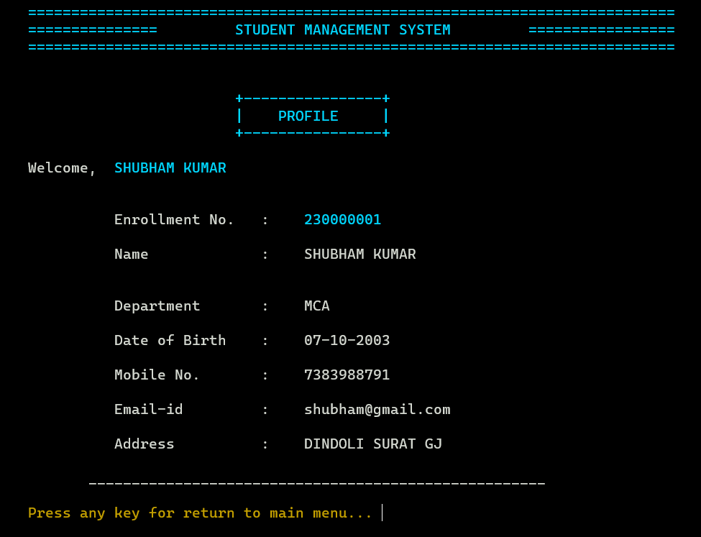
Screen Shorts

Slide 36
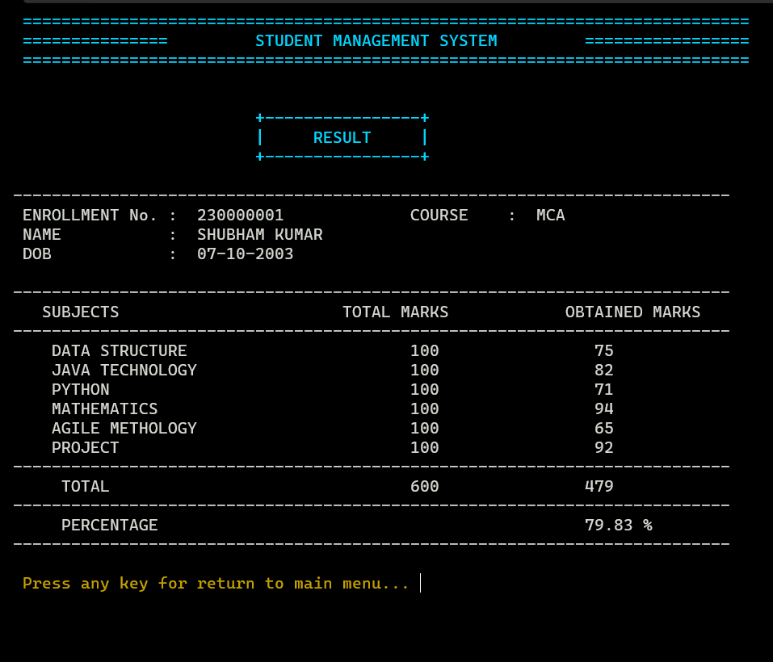
Screen Shorts

Slide 37
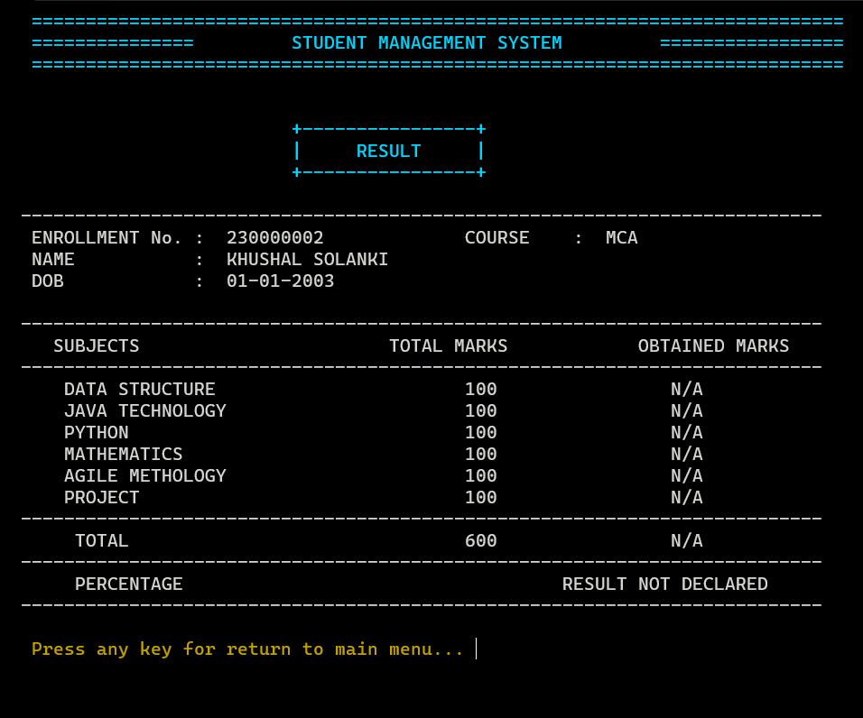
Screen Shorts

Slide 38
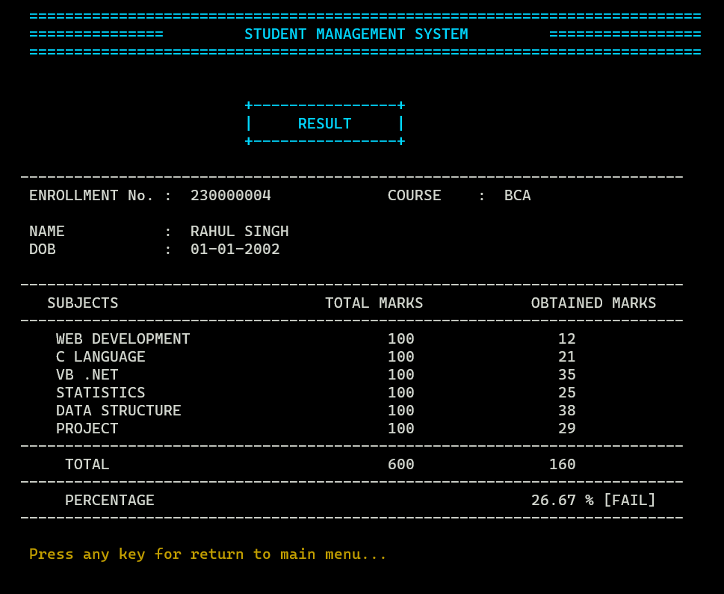
Screen Shorts

Slide 39
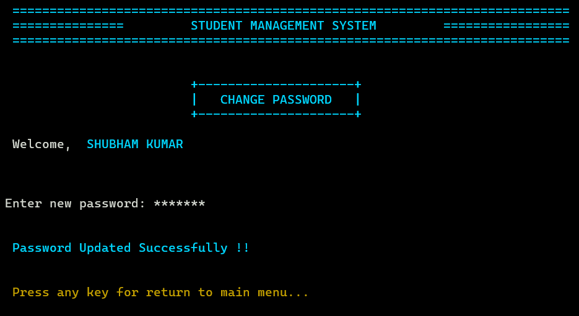
Screen Shorts

Slide 40
Advantages
Time and Cost Savings: : Reduces the time and costs associated with manual record-keeping and administrative tasks, allowing institutions to allocate resources more efficiently. Efficient Grade Management : In this system student can easily view their marks by login and password which is updated by teachers or faculties. Improved Accessibility: Provides easy access to information for all admin, allowing faculties and students to track any changes like profile, marks etc.

Slide 41
Limitations
User-Interface : Complex-user interface may lead to increased difficulty in acceptance of the student management application among the institute staff. User Authentication and Authorization : Implementing robust user authentication and authorization mechanisms is essential. If not properly implemented, there is a risk of unauthorized access to sensitive information. Scalability Issues: As the student management system grows and the amount of data increases, managing scalability can be challenging, especially without automatic memory management.

Slide 42
References
https://www.cprogramming.com/ https://www.w3schools.com/c/index.php https://www.geeksforgeeks.org/c-programming-language/

Slide 43
Thank You

